Slide 1
Agenda
Session I
Distributed DNN training overview
When the network is the bottleneck
SwitchML: In-network aggregation
SwitchML hands-on
Training with SwitchML
SwitchML API
Session II
OmniReduce: Sparse collective communication
OmniReduce hands-on
GRACE: Gradient compression
GRACE hands-on
Implement and run a gradient compression algorithm

Slide 2

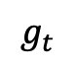
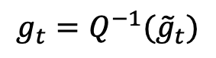
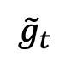
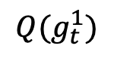
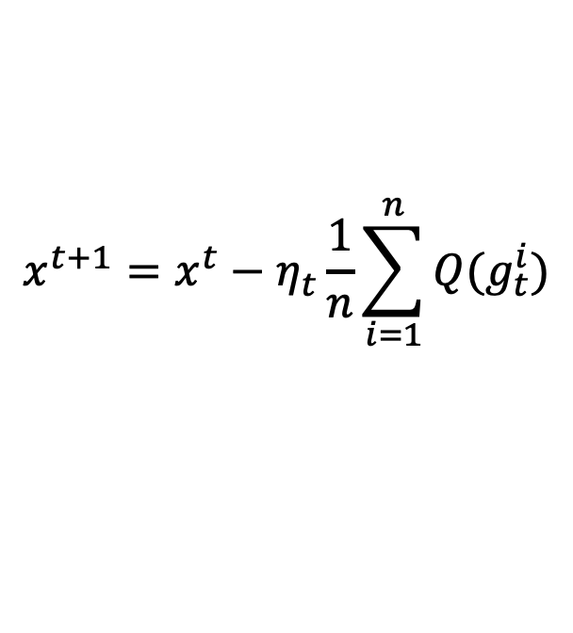
Compressed Communication
OR
PS
AllReduce
Compression at W¹
$$Q(g_{t}^{1})$$
Receive
$${\tilde{g}}_{t}$$
Send
Recover
$$g_{t}=Q^{−1}({\tilde{g}}_{t})$$
$$g_{t}$$
$$g_{t}$$
$$g_{t}$$
W¹
W²
W³
W⁴
$$x^{t+1}=x^{t}−η_{t}\frac{1}{n}\sum_{i=1}^{n}{Q(g_{t}^{i})}$$
Compression
Notes:
From previous discussions we know that network is a bottleneck in distributed DNN training
one way to alleviate it is to apply compressed communication, send fewer data
we know that workers obtain averaged gradients by communicating with others
we can apply compression on the gradient, send and receive compressed form of gradients and recover
formally, the Q in the SGD equation denotes compression function, where superscript I is the index of workers and subscript t mean iteration number

Slide 3
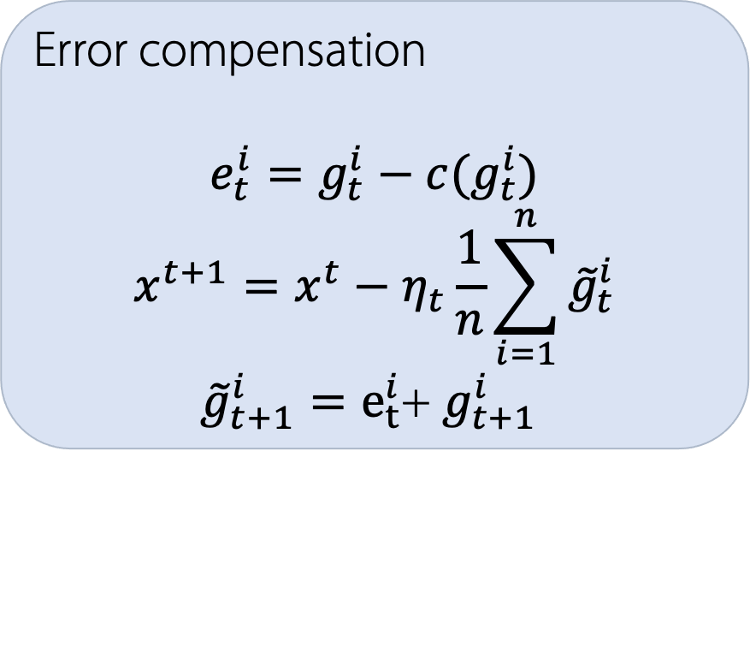

Error Compensation (aka Memory)
Biased Compression
Typically, smaller variance than unbiased
Solution → But, may diverge
Error Compensation
$$E\left(c\left(x\right)\right)≠x$$
Compressor
Error compensation
$$e_{t}^{i}=g_{t}^{i}−c(g_{t}^{i})$$
$$x^{t+1}=x^{t}−η_{t}\frac{1}{n}\sum_{i=1}^{n}{{\tilde{g}}_{t}^{i}}$$
${\tilde{g}}_{t+1}^{i}=e_{t}^{i}$+ $g_{t+1}^{i}$
After compensation
Compensate in next step
Notes:
while compression does save the traffic, it typically hurts model quality
recent research theoretically analyzes and suggests that we apply error compensation to biased compression, where biased compression means the expectation of compressed gradient does not equal to the original gradient
error compensation records the difference between original and the compressed gradients, and compensates that in the next iteration

Slide 4
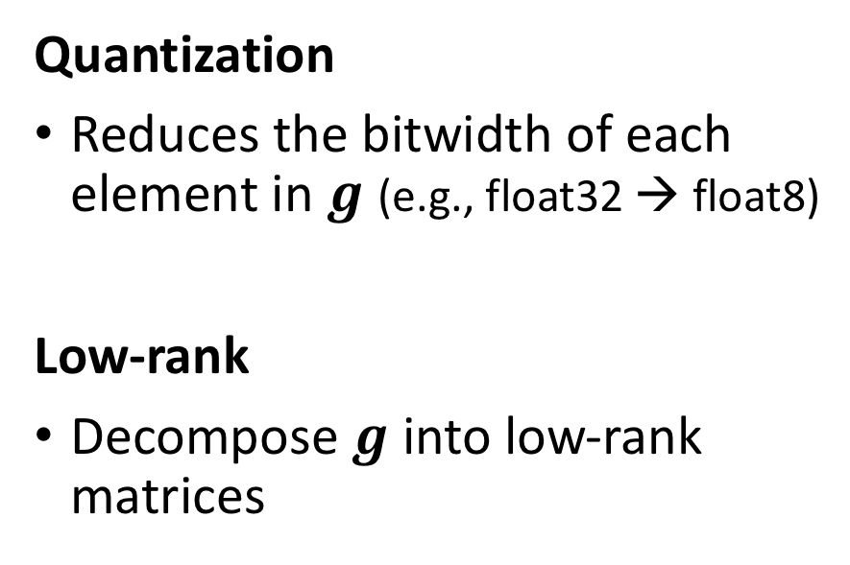
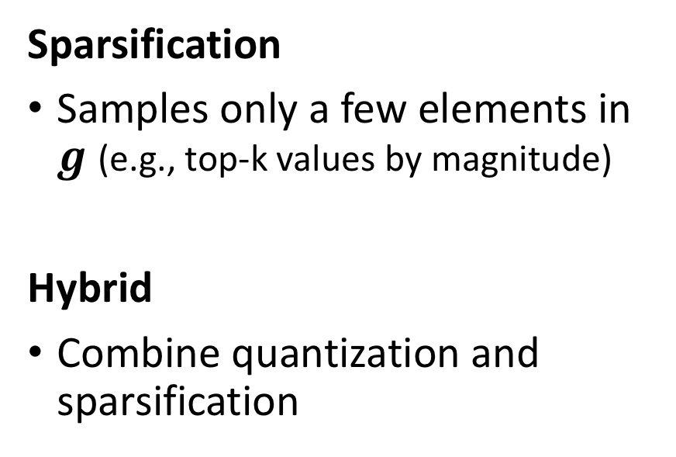
Categories of Compressed Communication
Quantization
Reduces the bitwidth of each element in $g$ (e.g., float32 → float8)
Low-rank
Decompose $g$ into low-rank matrices
Sparsification
Samples only a few elements in $g$ (e.g., top-k values by magnitude)
Hybrid
Combine quantization and sparsification
Notes:
we can categorize compression methods into the following four types:
1 2 3 4
next, I will briefly go through some well known methods in each category

Slide 5
1-bit Quantization
-1.7 | 2.9 | 10.5 | 11.4 | -23.1 | 0.88 | 1.01 | 0 | 5.51 | -0.98
Original Gradient
τ = 1
0 | 1 | 1 | 1 | 0 | 0 | 1 | 0 | 1 | 0
- | + | + | + | - | + | + | + | + | -
1-bit SGD
sign SGD
Decode
-’s to mean of negative values
+’s to mean of non-negative values
1-bit SGD
F. Seide et al., “1-Bit Stochastic Gradient Descent and Application to Data-Parallel Distributed Training of Speech DNNs”, Interspeech, 2014.
J. Bernstein et al., “signSGD: Compressed Optimisation for Non-Convex Problems”, ICML, 2018.
J. Bernstein et al., “signSGD with Majority Vote is Communication Efficient And Fault Tolerant”, ICLR, 2019.
S. P. Karimireddy et al., “Error Feed-back Fixes Sign SGD and other Gradient Compression Schemes”, ICML, 2019.
signSGD
SIGNUM→signSGD with momentum
EFsignSGD→signSGD with error compensation
Notes:
first for quantization, there are methods that quantize values to 1 bit
1-bit SGD use 1 for all positive values and 0 otherwise
while sign SGD use the sign bit along with the mean of values
built on top of sign SGD, there are also signum with momentum and EFsignSGD with error compensation

Slide 6
TernGrad - Quantization
Uses {−1, 0, 1} scaled by the infinity norm of the stochastic gradient to obtain the quantized stochastic gradient
Original
gradient
Quantized
gradient
0.49
19.3
-0.78
-0.33
-19.2
3.11
-4.02
0
1
1
0
0
1
1
0
1
-1
0
0
1
-1
b =
19.3 .
Infinity
norm
Component- wise product
Random from
Bernouli distribution
W. Wen et al., “TernGrad: Ternary Gradients to Reduce Communication in Distributed Deep Learning”, NeurIPS, 2017.
Notes:
TernGrad uses a ternary representation scaled by the infinity norm of the gradient
whether an element is chose or not is determined by sampling from a bernoli disbutionw with probabilities proportional to the absolutie value

Slide 7
Natural Compression - Quantization
Rounds the gradient components to one of the two closest integer powers of 2
Unbiased compression
S. Horvath et al., “Natural Compression for Distributed Deep Learning”, arXiv:1905.10988v2, 2019.
Notes:
finally, I introduce natural quantization which essentially wipes out the mantissa part of the floating point representation and as a result always quantizes a floating point value to on of the two nearst power of 2 numbers
for example 2.5 is quantized to 2 or 4 with probabilities inversely proportional to the distance

Slide 8
Top-k, Random-k - Sparsification
Top-k
Select k elements with largest absolute values
Biased
Rand-k
Select random k elements
Can be made unbiased by multiplying with (total # of elements) / k
F. Aji et al., “Sparse Communication for Distributed Gradient Descent”, EMNLP-IJCNLP, 2017.
S. U. Stich et al., “Sparsified SGD with Memory”, NeurIPS, 2018.
D. Alistarh et al., “The Convergence of Sparsified Gradient Methods”, NeurIPS, 2018.
Notes:
next, we introduce sparsification methods,
the most well-known methods are probably topk and randomk
randomk randomly selects k% elements
while topk selects elements whose magnitudes is the biggest top k%

Slide 9
Threshold - Sparsification
Threshold: Select the elements whose absolute values are larger than a fixed threshold value τ
0.49
19.3
-0.78
-0.33
-19.2
3.11
-4.02
19.3
-19.2
-4.02
τ = 4
N. Strom, “Scalable Distributed DNN Training using Commodity GPU Cloud Computing”, INTERSPEECH, 2015.
τ may also be adaptive
N. Dryden et al., “Communication Quantization for Data-Parallel Training of Deep Neural Networks”, MLHPC, 2016.
Notes:
previous methods send fixed amount of data,
another method threshold selects elements whose magnitude is larger than some threshold, which may be fixed or adaptive

Slide 10
Qsparse SGD - Hybrid
Hybrid method
Combines sparsification with quantization
31.7
40.2
31
40
-7.9
-2.3
31.7
40.2
Quantization
D. Basu et al., “Qsparse-local-SGD: Distributed SGD with Quantization, Sparsification and Local Computations,” in NeurIPS, 2019
Notes:
next is the hybrid method which combines sparsification with quantization
an example is Qsparse SGD

Slide 11
ATOMO, GradiVeQ, PowerSGD, GradZip – Low-rank
ATOMO: minimize variance of stochastic gradient
GradiVeQ: uses SVD
PowerSGD: decompose by power iterations
GradZip: similar to PowerSGD with an additional regularizer
H. Wang et al., “ATOMO: Communication Efficient Learning via Atomic Sparsification”, NeurIPS, 2018.
M. Yu et al. “GradiVeQ: Vector Quantization for Bandwidth-Efficient Gradient Aggregation in Distributed CNN Training”, NeurIPS, 2018.
T. Vogels et al., “PowerSGD: Practical Low-Rank Gradient Compression for Distributed Optimization”, NeurIPS, 2019.
M. Cho et al., “GradZip: Gradient Compression using Alternating Matrix Factorization for Large-scale Deep Learning”, NeurIPS, 2019.
Notes:
finally, low-rank methods decompose gradient matrices to low rank vector
there are different

Slide 12
GRACE: Framework and Benchmark for Compressed Communication
Code at https://github.com/sands-lab/grace
Notes:
with so many gradient compression methods introduced, now I’m going to describe our work grace…

Slide 13
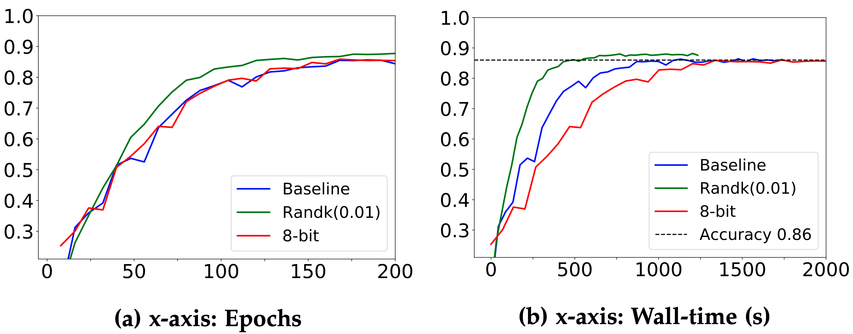
Convergence Speed – Theory vs Practice
Which gradient compressor is better and when?
No standardized evaluation
Unclear how different factors affect the relative performance
DNN architecture, compression level, communication style, …
VGG16
CIFAR-10
TensorFlow
8 workers
25 Gbps network
Top-1 Accuracy
Notes:
the main problem is that there are so many different methods and no standardized evaluation methods
it is also unclear how different factors may affect the relative performance of a compression method
for example in the figure below we compare 3 setups .
in the left figure we show accuracy to epochs, which one can observe that the 8-bit and randomk methods performs equally well to the baseline
but if you plot accuracy to wall time as in the right figure, surprisingly one can see that 8-bit method actually slowers the job.

Slide 14
Implementation
SignSGD
SIGNUM
QSGD
TernGrad
Top_{k}
Rand_{k}
Threshold_{k}
Adaptive Sparse
Adaptive Quantization
1-bit SGD
8-bit Quantization
Deep Gradient Compression
PowerSGD
SketchML
C_{NAT}
Quantization & Sparsification
Optimizers
SGD, AdaGrad, ADAM,…
Popular frameworks
TensorFlow
PyTorch
P2P & Master/Worker
Horovod (OpenMPI, NCCL)
Notes:
to address these problems, we aim to develop a framework called grace that exposes unified high-level APIs that people can use to develop their compression methods.
we integrate grace to popular ML frameworks like tensorflow and pytorch. and we devise a set of dnn training benchmarks
so that if you use grace to develop compression methods, you already have access to a set of benchmarks and your results are comparable to other methods.

Slide 15
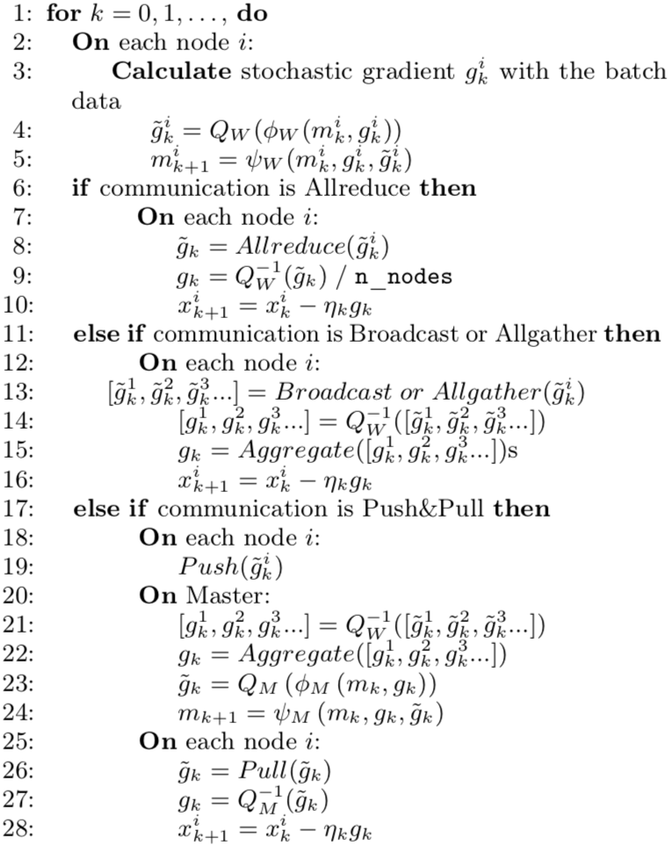
API
WORKER
Compress
Quantize
Sparsify
Pack
useMemory
updateMemory
Notes:
now let’s walk through what workers and servers do during training
in the pseudo code you can see a loop of k, which is the training iteration
if you consider a single worker setup, what a worker does is the same as highlighted in red rectangles
so for each iteration a worker calculate stochastic gradients and apply updates to the model
now if we have multiple workers, they need to communicate with one another, and depending on the communication pattern details slighly differ
but the core idea is highlighted in the red rectangles here, namely, compress from the worker side, collect all updates, decompress those updates and finally aggregate them.

Slide 16
GRACE Example
class TopKCompressor(Compressor):
def __init__(self, ratio, mem=NoneMemory(), comm=Allgather()):
super().__init__(mem, comm)
self.ratio = ratio
def compress(self, tensor, name):
shape = tensor.size()
tensor = tensor.flatten()
values, idx = self.sparsify(tensor, self.ratio, torch.topk)
ctx = tensor.numel(), shape
return [values, idx], ctx
def decompress(self, comps, ctx):
numel, shape = ctx
values, idx = comps
t = self.desparsify(numel, values, idx)
return t.view(shape)
Provides a unified API
sparsify/desparsify
quantize/dequantize
Error feedback support
Compensate for errors accumulated due to lossy compression
AllReduce & AllGather communication strategy
PyTorch and TensorFlow support
Notes:
now comes to the most important part, the compressor implementation,
we use topk in PyTorch as an example, and you can see the actual API here includes compress and decompress
in compress you are given a gradient tensor and you return the compressed form and any context data you need for decompression
the data then goes for communication module and when they are back, GRACE invoke your decompress method and finally aggregate the results
so in decompress you have the compressed form and context and you return the decompressed gradient updates.
As previouly mentioned we support error feedback, different communication strategy and frameworks.

Slide 17
Comparison of 16 compressors
NCF benchmark example on ML-20m dataset on an 8-worker, 1 x V100 each, 10 GbE network
Results are relative to no compression baseline
Compression not always a win
Volume and quality not always correlate
Notes:
here I present our implementation of 16 compression methods and the comparison of them
we train NCF model on the movie lens dataset which is a recommendation task
we run in a 8-worker environment with 10GbE network and each node has 1 V100 GPU
the plot shows the evaluation metric hit rate on y axis and for x axis its relative throughput on the left and data volumn on the right
both metrics are relative to the no compression baseline
so the vertical 1 denotes the baseline quality
the takeaway is that compression is not always a win because while you save the amount of data transferred, you introduce computation overheads
the other thing is volume and quality does not always correlate

Slide 18
Summary
Grace is a unified framework and benchmark for compressed communication
Main findings:
No compressor is overall best
Computational overheads of compression are not negligible
DNN architecture, collective libraries, bandwidth all have an impact

Slide 19
Questions?

Slide 20
Hands-on
Migrate to GRACE from existing training scripts
Implement custom compressor

